Slide 1


CV Raman Major Grant Scheme (2026)
Title
PI
Affiliation of PI
Co-PI
Affiliation of Co-PI
PS: PIs are requested to prepare a PowerPoint presentation of their project proposal and record their presentation, with a duration not exceeding 7 minutes

Slide 2
CV Raman Grant Scheme
(CSJMU)
Have u availed CV Raman Grant (CSJMU) earlier : YES/ No
If Yes, mention Year :
If Yes, mention outcomes (Publication(s)/ Patent(s) etc. :

Slide 3
Introduction
Hint: The introduction must focus on identifying and addressing key research gaps.

Slide 4
Objectives

Slide 5
Methodology
Hint: Prepare Flowchart- style methodology

Slide 6
Timeline
Hint: Please represent the project phases by Gantt chart

Slide 7
Translational Outcome(s)
Please mention project outcomes such as product/ patent/technology/ tool/ policy document/ other translational output etc.

Slide 8
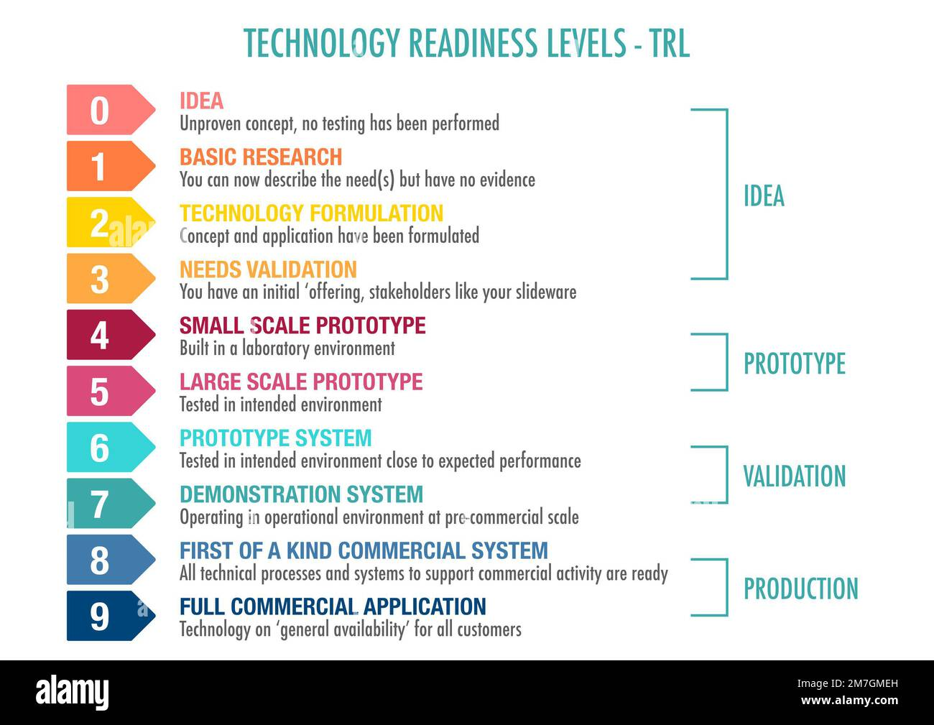
Technology Readiness Level Progression
Current TRL of the proposed project at the time of submission:
Target TRL to be achieved by the end of the project:
(HINT: Please see the scale alongside)
Kindly assess and indicate the Technology Readiness Level (TRL) of your project proposal on a 0–10 scale.

Slide 9
Budget
Kindly provide a detailed budget justification for the proposed project, clearly explaining the need and allocation of funds under each budget head.

Slide 10
Additional information
(if any)

Slide 11
THANK YOU

